Slide 1
Long-Range Weather Forecasting Using Global Oscillations & Machine Learning Approaches
Alex Grossman, Scott Bowman & Sai Ravela
Massachusetts Institute of Technology
Fulvio Fabrizi & Tom Reynolds
MIT Lincoln Laboratory
3/21/19

Slide 2



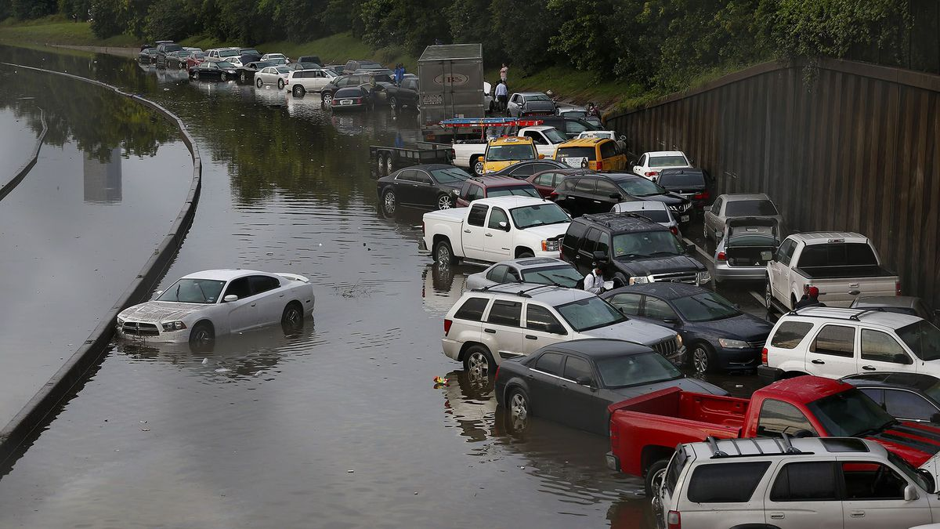
Motivation
Growing need for long-range (months-years) weather forecasting for multiple global locations for different mission areas
Very challenging due to complex interactions between atmospheric & oceanic cycles at long lookahead times which cannot be effectively modeled using traditional short-range forecasting techniques (e.g., numerical simulations)
International Security
Humanitarian Assistance
Disease Dynamics
Infrastructure Planning

Slide 3
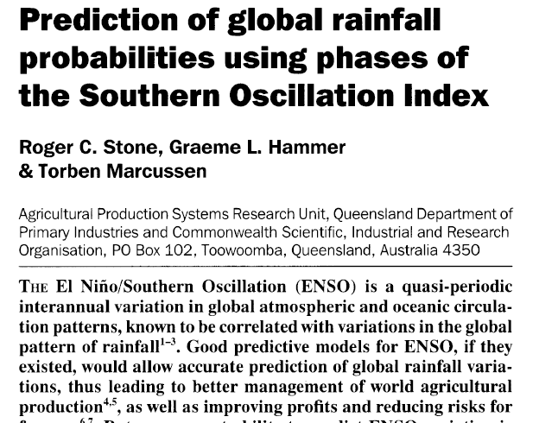



Current Opportunity
Many prior studies have examined relationship between a small number of “global oscillations” and climate impacts which reduce their generalizability
Significant opportunity afforded from applying machine learning approaches, trained on decades of full set of global oscillation & resulting climate data
Oscillations interact differently according to geographic location & time-scale
Geophysical Research Letters, 1999
Nature, 1996

Slide 4
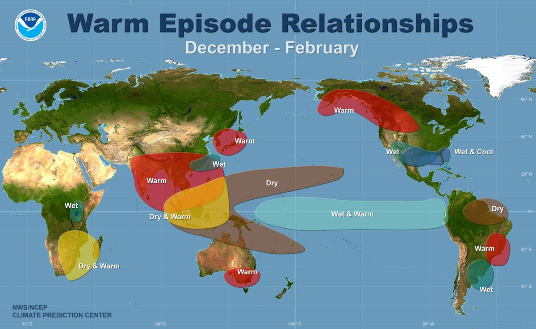
Global Oscillations
A global oscillation (aka “teleconnection”) is a recurring and persistent, large-scale pattern of pressure or atmospheric/oceanic circulation that spans vast geographical areas. These patterns typically last for several weeks to several months, they can sometimes be prominent for several consecutive years.
Combining multiple teleconnections can enhance or negate the impact of other teleconnections
A warm episode ENSO is displayed on
the right with its associated global
impacts
ENSO

Slide 5
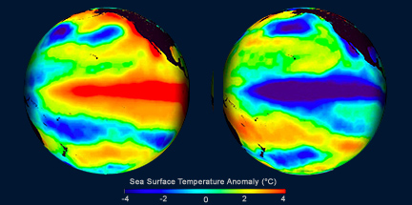
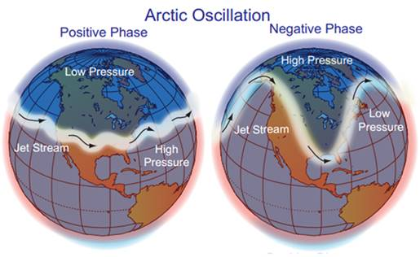
Key Oscillations
El Niño/Southern Oscillation (ENSO)
Warm and cold water episodes near the equator in the Pacific
Affects weather patterns around the globe
Arctic Oscillation (AO)
Atmospheric pressure at polar and middle latitudes fluctuates between high and low
North Atlantic Oscillation (NAO)
Changes in the intensity / location of the North Atlantic jet stream/storm track
ENSO
NAO

Slide 6
Other Global Oscillations
East Atlantic Pattern: Anomaly centers spanning the North Atlantic from east to west. Similar to NAO
West Pacific Pattern: Atmospheric pressure differences from the Bering Sea to southeast China
East Pacific/North Pacific Pattern: Positive height anomalies located over Alaska/ Western Canada, and negative anomalies over the central North Pacific and eastern North America
Pacific/North American Pattern: Strong fluctuations in the strength/location of the East Asian jet
East Atlantic/West Russia Pattern: Height anomalies located over Europe and northern China, and height anomalies located over the central North Atlantic and north of the Caspian Sea
Scandinavian Pattern: Height anomalies over Scandinavia, with weaker centers of opposite sign over western Europe and eastern Russia / western Mongolia
Tropical/Northern Hemispheric Pattern: Large changes in both the location / eastward extent of the Pacific jet stream
Polar/Eurasia Pattern: Associated with fluctuations in the strength of the circumpolar circulation
Pacific Transition Pattern: Anomalies of 500-hPa heights from the central subtropical North Pacific to the eastern US
Antarctic Oscillation: A belt of westerly winds or low pressure surrounding Antarctica which moves north or south as its mode of variability
Pacific Decadal Oscillation: SST anomalies of one sign in the north-central Pacific and SST anomalies of another sign to the north and east near the Aleutians and the Gulf of Alaska
SST = Sea Surface Temp

Slide 7
Machine Learning Approach
Application Phase
Oscillation index forecasts
Location of interest
Training Phase
Oscillation index archives
(NOAA)
1950 - today
Machine Learning algorithm relating global oscillation & climate effects
Machine Learning algorithm relating global oscillation & climate effects
Machine Learning algorithm relating global oscillation & climate effects
Machine Learned algorithm
Location X
Global climate archives
(NOAA, WMO, etc)
1950 - today
Climate
forecasts
What is best machine learning algorithm & input data?
How generalizable are the models spatially?
What is performance at different lookahead times?
What is performance for mean vs extreme events, etc.
What are actionable performance requirements?
Location X
Location Y
Location Z

Slide 8
Initial Test Data
Oscillation data
Data extracted for key oscillations from the NOAA Climate Prediction Center (CPC) for January 1950-today
Teleconnection “indices” provide normalized standard deviations of 500mb height anomalies for atmospheric patterns or sea water temperatures for oceanic patterns relative to mean
Teleconnections are identified as being positive or negative in nature depending upon how far removed from their 500mb height patterns they are from their norm, for a given time of year. For the ocean it is based on whether the ocean temperature is above or below normal in a given location for a given time of year
More details on index calculation technique available here: https://www.cpc.ncep.noaa.gov/data/teledoc/teleindcalc.shtml
Climate data
Monthly climate obtained for 10 locations in southern New England from January 1950 to present day from NOAA National Centers for Environmental Information
Monthly average temperatures, snowfall and rainfall
Climate data for other global locations could easily be added (either public or restricted datasets)

Slide 9
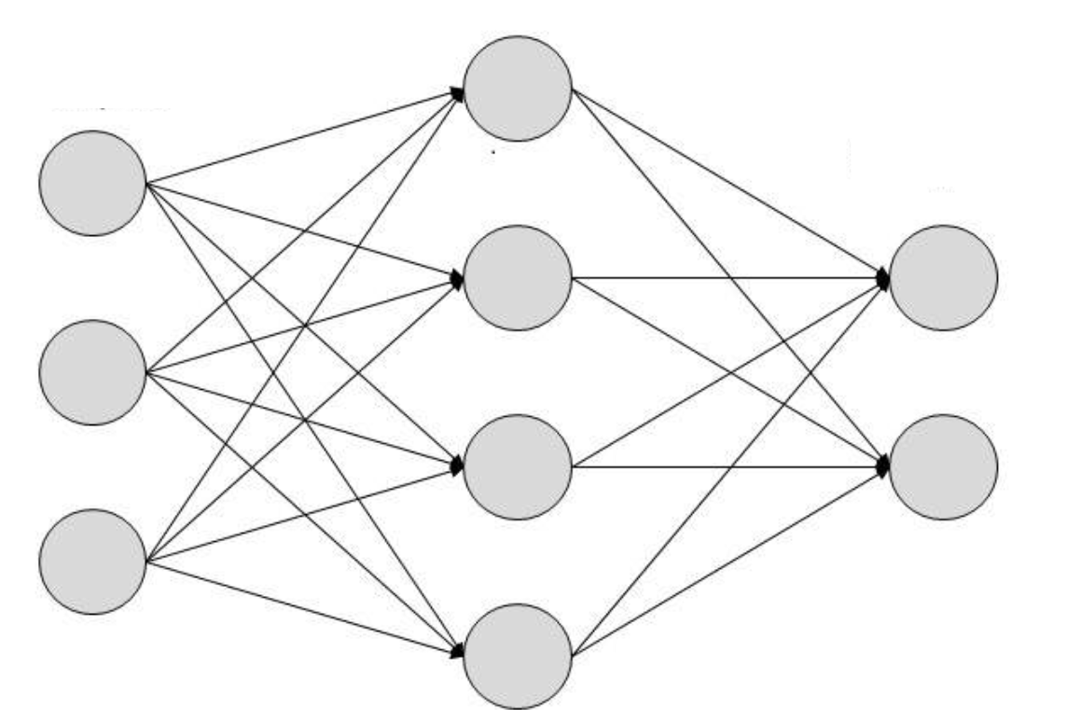
Initial Method Details
Initial study uses feed-forward neural network
Other models also viable and will be explored
Teleconnections
Site-Network Model
Undirected Graphical Model (probabilistic)
Hidden layers try to figure out relationships
Neural Network Model (deterministic)
Location inputs chosen
Site 1
Site 2
Site 3
Site N-1
Site N
Site-Local Models
Notes:
[Sai ] – They are not “Inputs” – they are outputs. Inputs at the bottom. We don’t want to correlate the sites, we want to use a background (however stationary) correlation model for inference; we aren’t trying to correlate them per se, but we are trying to look for “site differentiators” that correlation provides

Slide 10
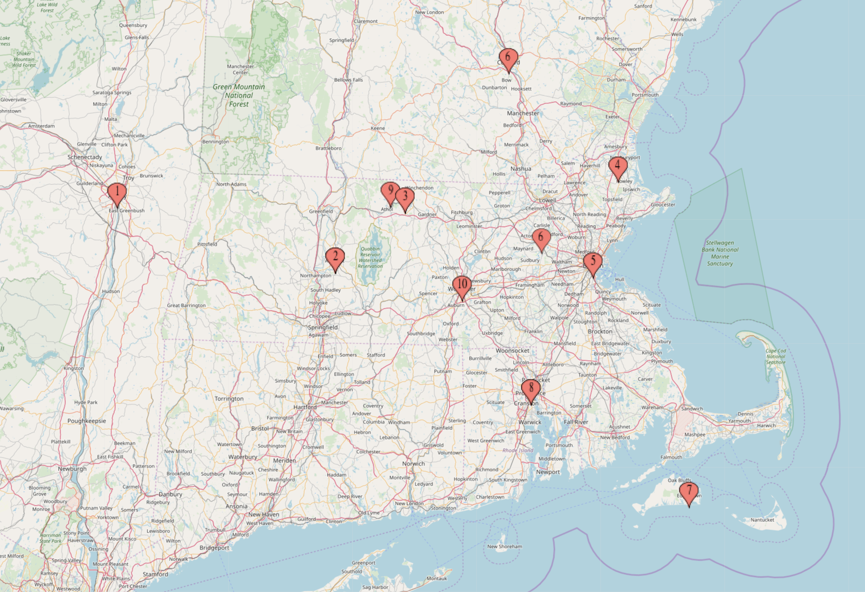
Sample Application
Initial indicators: NAO, AO, PDO, ENSO, PNA; Using 48 months of past data.
Initial predictors: Temperature difference, Snow difference, Rain difference
Initial test sites:
Albany, NY
Amherst, MA
Birch Hill Dam, MA
Blue Hill, MA
Boston, MA
Concord, NH
Edgartown, MA
Providence, RI
Tully Lake, MA
Worcester, MA

Slide 11
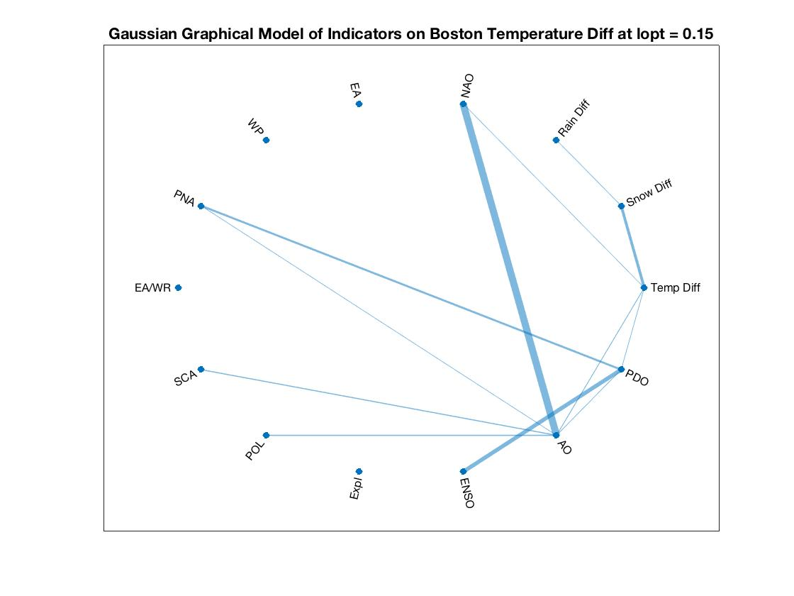
Why These Indicators?
We used graphical models again for each of the individual locations to determine which indicators are the most correlated and predictive of the predictors
Since all of our locations are focused in the Southern New England area for testing, as expected, all were most correlated with similar indicators
An example of this for Boston:
Notes:
[Sai] Solves an L1 Problem for the sparsity structure of the graphical model, eliminating edges that are unimportant as a predictor. The hyperparameter (regularizing term) is estimated using BIC in our initial approach. This is standard formulation, see Hastie et al.

Slide 12
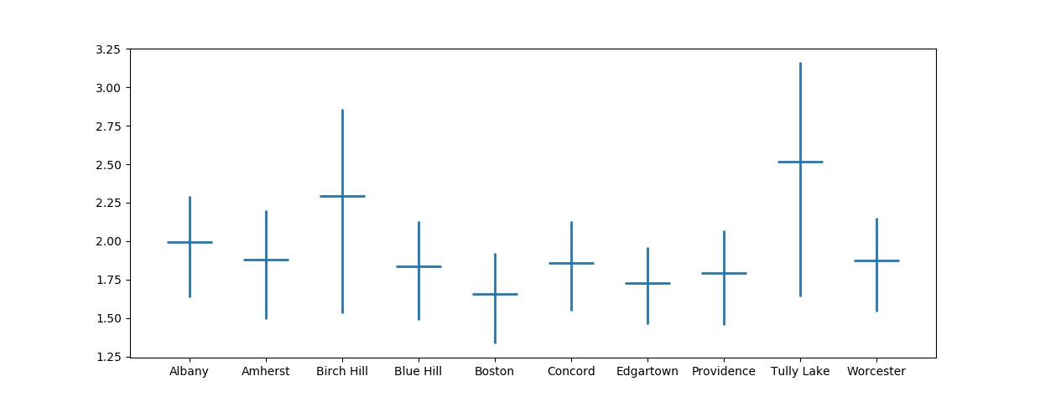
Local Results – Independent Site Predictions
Our model was tested individually for each location and produced a 99% confidence interval representing squared error values in cross-validation.
Neural Network Tested on Separate Local Data using 5-fold Cross-Validation Method (Predicting 6 months in the future)
These preliminary results represent significant performance improvements over other candidate approaches: - At least 50% better than inter-annual average
- Currently benchmarking against other candidate approaches
Error (±K)
Location
Notes:
LSTM (Long Short Term Memory) is the popular time-series neural network model with great results on Hurricane Prediction, and somewhat modest results on temperature prediction, according to some published research. We trained an “equivalent” LSTM, optimizing over the parameters. However, most results online using NOAA data only predict daily results and use a clustering approach with a feed-forward network or polynomial regression on top of that for (we’re currently working on a clustering approach).

Slide 13
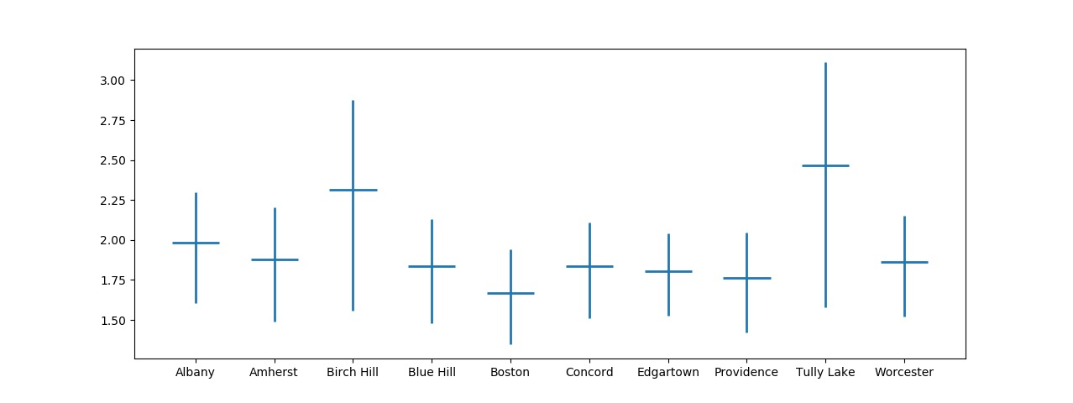
Global Results – Network Predictions
Our graphical model aims to improve accuracy by taking into account data at both the global and local levels, using past correlations between local predictions in addition to the local atmospheric data already being used. These results are with 99% confidence. ƛ = 0.05
These results would definitely improve as we add more sites, “global” implies using predictions at each location to improve all of the other locations, the method is described in more detail in Slide 20.
Belief Propagation on Graphical Model Tested with Global Data using 5-fold Cross-Validation Method
(Predicting 6 months in the future)
Error (±K)
Location

Slide 14
Current Conclusions
Application of machine learning approaches with global oscillation and local climate data over decades shows significant promise for long-range climate forecasting
Planned next steps
Refine technical approach (e.g., see next slide) to meet needs of different mission areas
Quantify performance of different variants of approach for range of relevant parameters:
Geographic locations (e.g., global regions of interest to mission)
Look ahead times (e.g., predictive performance over 6, 12, 18, 24+ months into future)
Climate metrics (e.g., temperature, precipitation rates, etc.)

Slide 15
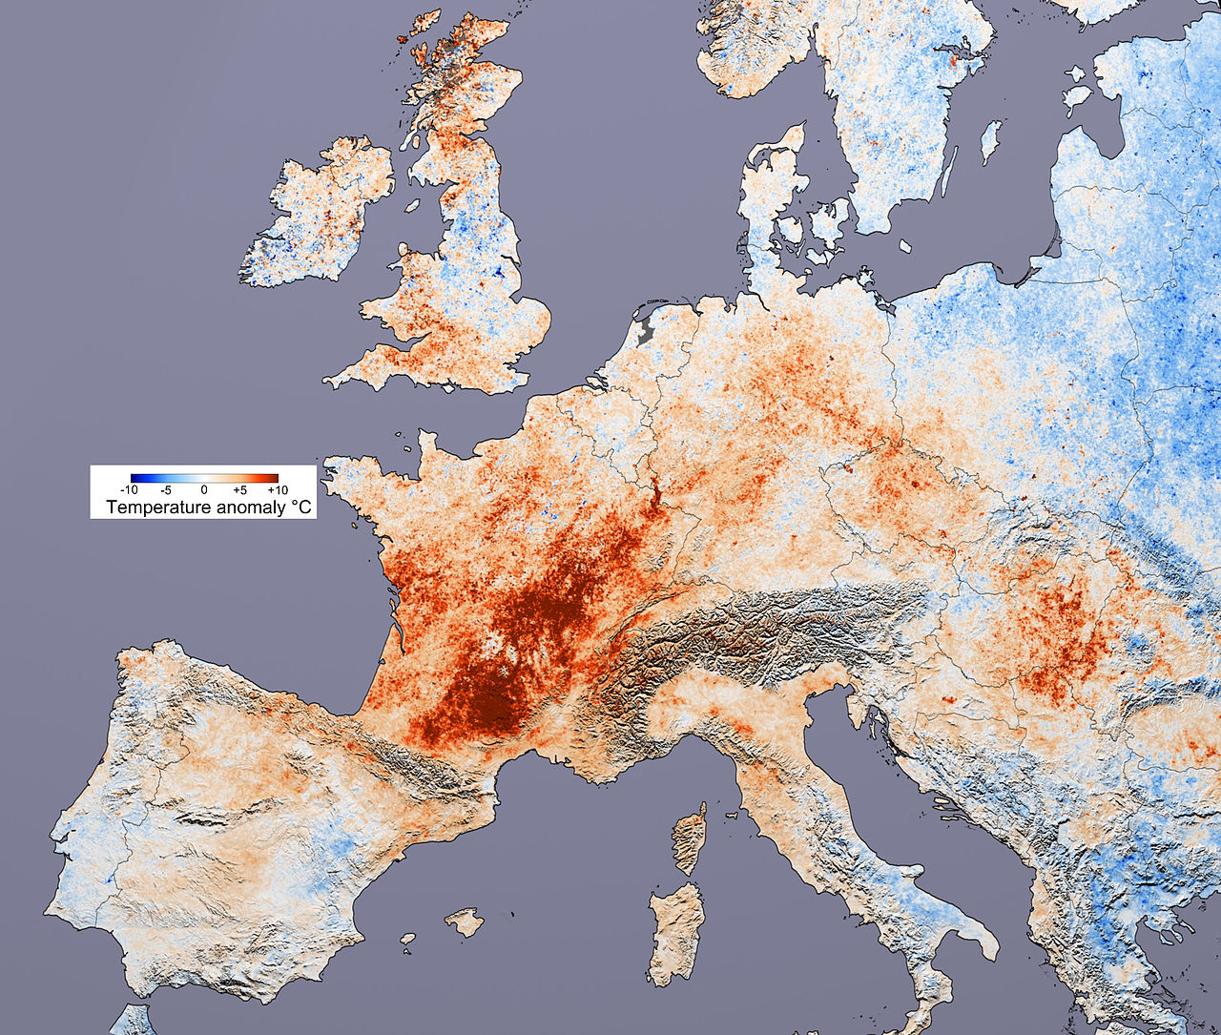

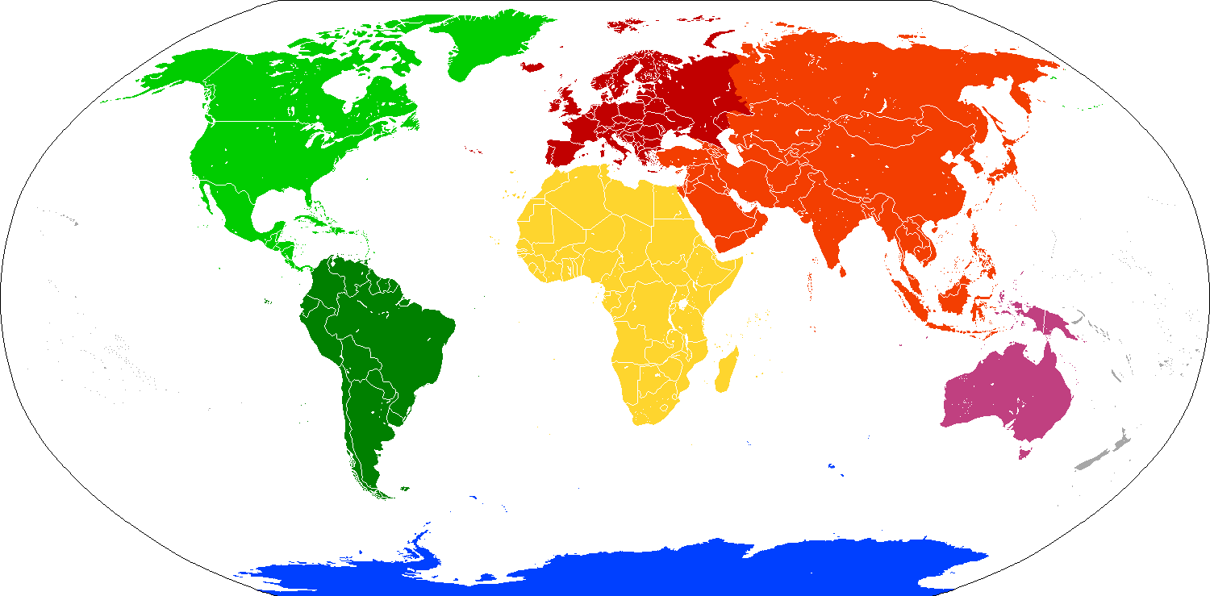
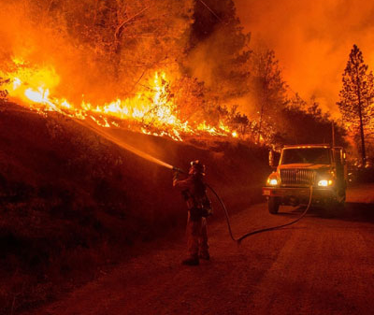


Current Activities
Extending/refining techniques tuned to mission-relevant reference cases
Seeking examples dispersed geographically & across events (extremes of temperature, drought, flood, etc)
European heat wave, 2003
Hottest summer in at least 400 years, 70,000 deaths across Europe
Syrian drought, 2006-2010
The worst drought in 900 years coupled with a large population growth and often cited as the trigger for the civil war
CA fire season, 2018
Deadliest & most destructive on record
Ethiopia drought, 1983-1985
>400,000 deaths, 400,000 external refugees,
2.5 million internally displaced
Pakistan flooding, 2010
Nearly 2,000 deaths,
20% of country flooded

